Slide 1

COMP3074 Mobile App Development I
Week 1

Slide 2
Toast in Android
A toast provides simple feedback about an operation in a small popup. It only fills the amount of space required for the message and the current activity remains visible and interactive.
Let’s copy the code from the link below and see how we can display the toast!.
https://developer.android.com/guide/topics/ui/notifiers/toasts.html
IntelliJ IDE shortcut:
https://resources.jetbrains.com/assets/products/intellij-idea/IntelliJIDEA_ReferenceCard_mac.pdf
Notes:
https://support.apple.com/en-us/HT201236

Slide 3
Application architecture
An Android application consists of one or more of the following classifications:
Activities - an application that has a visible UI is implemented with an activity.
When a user selects an application from the home screen or application launcher, an activity is started.
Services - a service should be used for any application that needs to persist for a long time, such as a network monitor or update-checking application.
Notes:
Without activities we cannot make apps. There is piece of code that marks the entry point in our apps as we have different activities in the apps, we can mark one as the entry point.
Apps cannot communicate between each other for security reasons, so there are sandboxes. We can control how we want to provide the info of any kind (permissions)

Slide 4
Application architecture
Content providers play the role of database servers.
Used to manage access to persisted data, such as a SQLite database.
No need for content provider in simple applications.
Necessary in large applications that make data available to multiple activities or applications
Broadcast receivers - an Android application may be launched to process an element of data or respond to an event, such as the receipt of a text message.

Slide 5
Model View Controller
Common solutions for programming problems are called patterns
Let’s see the video below about MVC.
https://teamtreehouse.com/library/build-a-blog-reader-android-app/exploring-the-masterdetail-template/the-modelviewcontroller-mvc-design-pattern-2
Let’s get the example _01_FirstApp_GeoQuizis from week 2 and follow the example.
Let’s correct the answer!
Let’s continue the exercise of the MVC from chapter 2 in the book!.
Notes:
We use something similar, not exactly the same in the Android development. Not that structed as in ASP.

Slide 6
Android Studio Tips
http://developer.android.com/sdk/installing/studio-tips.html
IntelliJ IDEA
Android Studio and the Android plugin for IntelliJ IDEA are built from the same code, and all of the changes in Android Studio are, and will continue to be, available in IntelliJ IDEA releases.
www.jetbrains.com
Notes:
6

Slide 7
Activities
Activity: is an application component that provides a screen with which users can interact in order to do something, such as dial the phone, take a photo, send an email, or view a map.
Each activity is given a window in which to draw its user interface.
To create an activity, you must create a subclass of Activity:
public class Activity101Activity extends Activity {
/** Called when the activity is first created. */
@Override
public void onCreate(Bundle savedInstanceState) {
super.onCreate(savedInstanceState);
setContentView(R.layout.main);
}
}
Notes:
Activity could be defined as a self-contained function in an app. Prof explained it as a independent screen but it is more than that (basic explanation)

Slide 8
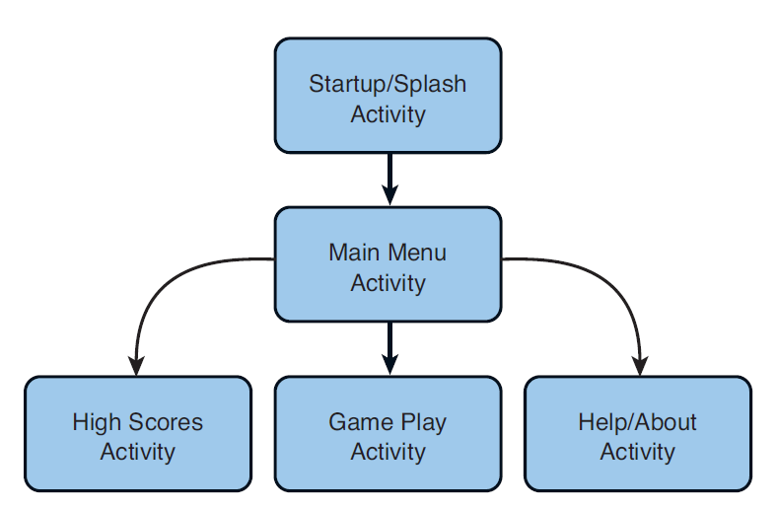
Performing Application Tasks with Activities
The Android Activity class (android.app.Activity) is core to any Android application:

Slide 9
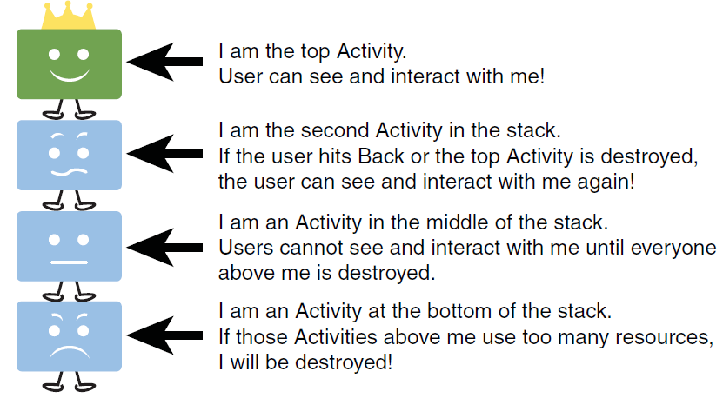
The Lifecycle of an Android Activity
Android applications can be multi-process, and the Android OS allows multiple applications to run concurrently

Slide 10
The Lifecycle of an Android Activity
When an activity transitions into and out of the different states, it is notified through various callback or life cycle methods.
All of the callback methods are hooks that you can override to do appropriate work when the state of your activity changes:
public class MyActivity extends Activity
{
protected void onCreate(Bundle savedInstanceState);
protected void onStart();
protected void onRestart();
protected void onResume();
protected void onPause();
protected void onStop();
protected void onDestroy();
}

Slide 11
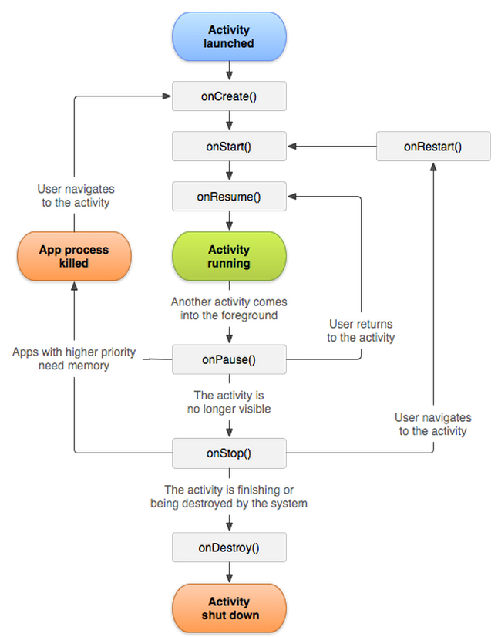
The Lifecycle of an Android Activity
Loops and the paths an activity might take between states:

Slide 12
Life Cycle Methods
Initializing Static Activity Data in onCreate()
any setup, such as layout and data binding, in the onCreate() method.This includes calls to the setContentView() method
Initializing and Retrieving Activity Data in onResume()
Activity becomes the foreground process, the onResume() method is called
start audio, video, and animations here
Stopping, Saving, and Releasing Activity Data in onPause()
Activity becomes the background process
stop any audio, video, and animations it started in the onResume() method
clean up and release any resources

Slide 13
Saving activity state
Under low-memory conditions, the Android OS can kill the process for any Activity that has been paused, or stopped,
The Activity state is saved into a Bundle object, assuming the Activity implements and uses onSaveInstanceState() for custom data
some View data is automatically saved
Destroy Static Activity Data in onDestroy()
When an Activity is being destroyed, the onDestroy() method is called

Slide 14
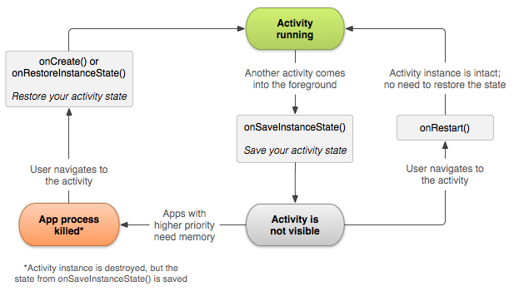
Saving activity state
When an activity is paused or stopped, the state of the activity is retained:
if your activity instance is destroyed and recreated, the state of the layout is restored to its previous state with no code required by you.
However, your activity might have more state information that you'd like to restore
http://developer.android.com/training/basics/activity-lifecycle/recreating.html
Notes:
Fragment: A small piece of activity that could be used inside multiple activities. For example, user’s login status being showed inside different pages of the app so we can reuse a fragment in all these pages’ Activities.

Slide 15


QUESTIONS

Slide 16
Activity101 example
public class Activity101Activity extends Activity {
String tag = “Lifecycle”;
/** Called when the activity is first created. */
@Override
public void onCreate(Bundle savedInstanceState) {
super.onCreate(savedInstanceState);
setContentView(R.layout.main);
// Called when the activity is first created. This is where you should do all of your normal static set up
}
public void onStart()
{
super.onStart();
// The activity is about to become visible.
}

Slide 17
Activity101 example
public void onRestart()
{
super.onRestart();
// Called after the activity has been stopped, just prior to it being started again. Always followed by onStart()
}
public void onResume()
{
super.onResume();
// The activity has become visible (it is now "resumed").
}
public void onPause()
{
super.onPause();
// Another activity is taking focus (this activity is about to be "paused").
}

Slide 18
Activity101 example
public void onStop()
{
super.onStop();
// The activity is no longer visible (it is now "stopped")
}
public void onDestroy()
{
super.onDestroy();
// The activity is about to be destroyed.
}
}

Slide 19
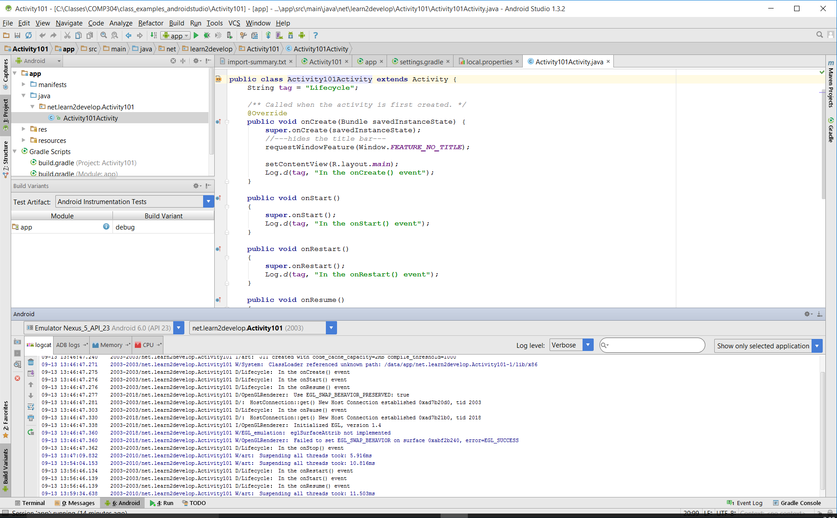
Activity101 example
Notes:
With the latest updates to the Android Support v7 AppCompat Library, revision 22.1, integrating Google’s Material Design has never been easier.
You will now see that ActionBarActivity has been deprecated. It has been replaced with AppCompatActivity, which will be used to cover the full scope of everything that is in AppCompat.

Slide 20
QUESTIONS

Slide 21
Application Anatomy
An Android application, along with a file called AndroidManifest.xml, is deployed to a device.
AndroidManifest.xml contains the necessary configuration information to properly install it to the device.
It includes the required class names and types of events the application is able to process, and the required permissions the application needs to run.
For example, if an application requires access to the network — to download a file, for example — this permission must be explicitly stated in the manifest file.
Many applications may have this specific permission enabled.
Such declarative security helps reduce the likelihood that a rogue application can cause damage on your device.

Slide 22
Defining Your Application Using the Android Manifest File
The Android application manifest file is a specially formatted XML file that must accompany each Android application.
This file contains important information about the application’s identity:
Application’s name
Version information
Application configuration information
The Android manifest file is named AndroidManifest.xml and must be included at the top level of any Android project

Slide 23
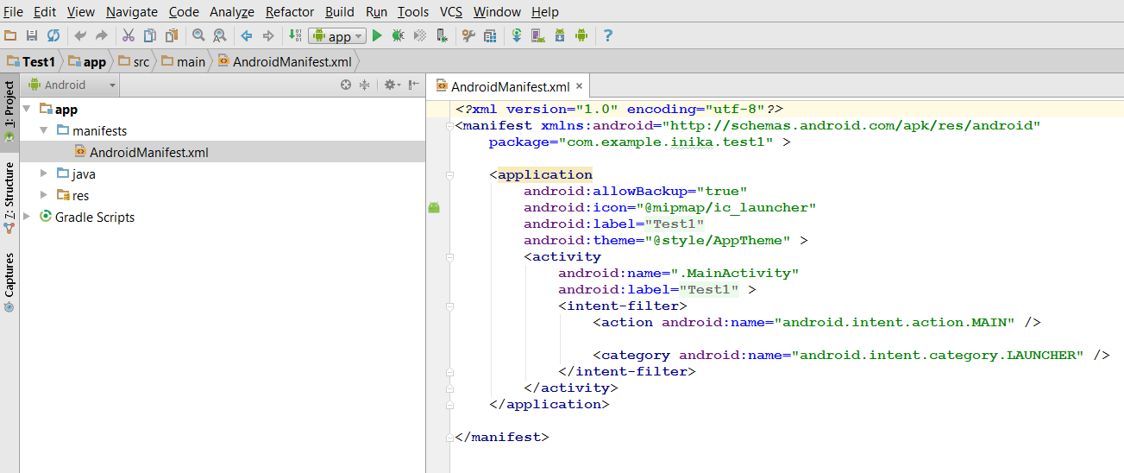
Editing the Android Manifest File
Opening Android Manifest File:

Slide 24
Managing Your Application’s Identity
The package name must be defined within the Android manifest file within the <manifest> tag using the package attribute
The version name (android:versionName) is a user-friendly, developer-defined version attribute.
<manifest xmlns:android="http://schemas.android.com/apk/res/android"
package="test.firstandroidapp"
android:versionCode="1"
android:versionName="1.0">

Slide 25
Managing Your Application’s Identity
android:versionName — A string value that represents the release version of the application code, as it should be shown to users.
The value is a string so that you can describe the application version as a <major>.<minor>.<point> string, or as any other type of absolute or relative version identifier. As with android:versionCode, the system does not use this value for any internal purpose, other than to enable applications to display it to users. Publishing services may also extract the android:versionName value for display to users.

Slide 26
Managing Your Application’s Identity
android:versionCode — An integer value that represents the version of the application code, relative to other versions.
The value is an integer so that other applications can programmatically evaluate it, for example to check an upgrade or downgrade relationship.
You can set the value to any integer you want, however you should make sure that each successive release of your application uses a greater value. The system does not enforce this behavior, but increasing the value with successive releases is normative.

Slide 27
Enforcing Application System Requirements
Application system requirements that developers can configure through the Android manifest file include:
The Android SDK versions supported by the application
The Android platform features used by the application
The Android hardware configurations required by the application
The screen sizes and pixel densities supported by the application
Any external libraries that the application links to

Slide 28
Setting Android SDKs
Android manifest file using the <uses-sdk> tag.This tag has three important attributes:
The minSdkVersion attribute: specifies the lowest API level that the application supports:
<uses-sdk android:minSdkVersion=“19" />
The targetSdkVersion attribute: specifies the optimum API level that the application supports:
<uses-sdk android:minSdkVersion=”19" android:targetSdkVersion=”23”

Slide 29
Specifying Supported Screen Sizes
The Android platform categorizes screen types in terms of sizes (small, normal, and large) and pixel density (low, medium, and high).
The <supportsscreen> tag can be used to specify which Android types of screens the application supports.
For example, if the application supports QVGA screens (small) and HVGA screens (normal) regardless of pixel density, the <supports-screen> tag is configured as follows:
<supports-screens android:smallScreens="true"
android:normalScreens="true"
android:largeScreens"false"
android:anyDensity="true"/>

Slide 30
Specifying Supported Screen Sizes
<supports-screens>
Lets you specify the screen sizes your application supports and enable screen compatibility mode for screens larger than what your application supports. It's important that you always use this element in your application to specify the screen sizes your application supports.
An application "supports" a given screen size if it resizes properly to fill the entire screen. Normal resizing applied by the system works well for most applications and you don't have to do any extra work to make your application work on screens larger than a handset device. However, it's often important that you optimize your application's UI for different screen sizes by providing alternative layout resources. For instance, you might want to modify the layout of an activity when it is on a tablet compared to when running on a handset device.

Slide 31
Registering Activities
The following XML code defines an Activity class called ActivityA:
<activity android:name=".ActivityA"
You may specify the complete class name:
<activity android:name="com.example.android.lifecycle.ActivityA" />
You can also enforce scope of the activity class by using the dot as a prefix in the Activity name:
<activity android:name=".ActivityB" />

Slide 32
Designating a Primary Entry Point Activity
Using an Intent Filter:
The following tag of XML configures the Activity class called ActivityA as the primary launching point of the application:
<activity android:name=".ActivityA"
android:launchMode="singleTask">
<intent-filter>
<action android:name="android.intent.action.MAIN" />
<category android:name="android.intent.category.LAUNCHER" />
</intent-filter>
</activity>

Slide 33
Registering Permissions
Android applications have no permissions by default
Must be explicitly registered within the Android manifest file
This example defines a permission using the <uses-permission> tag to gain access to the built-in camera:
<uses-permission android:name="android.permission.CAMERA" />
Notes:
Permissions are important and some permissions does required us to ask the user permission again during the run-time.
Permissions should be handled properly if user doesn’t allow anything.

Slide 34
Setting the Application Name and Icon
Set the application icon to a mipmap resource provided with the application package and the application label to a string resource:
<application android:icon="@mipmap/icon" android:label="@string/app_name">
set optional application settings as attributes in the <application> tag, such as the application description (android:description) and the setting to enable the application for debugging on the device (android:debuggable="true").

Slide 35
mipmap images different from the other familiar drawable images
For launcher icons when building density specific APKs. Some developers build separate APKs for every density, to keep the APK size down.
However some launchers (shipped with some devices, or available on the Play Store) use larger icon sizes than the standard 48dp.

Slide 36
mipmap images different from the other familiar drawable images
Launchers use getDrawableForDensity and scale down if needed, rather than up, so the icons are high quality.
For example on an hdpi tablet the launcher might load the xhdpi icon. By placing your launcher icon in the mipmap-xhdpi directory, it will not be stripped the way a drawable-xhdpi directory is when building an APK for hdpi devices.

Slide 37
QUESTIONS

Slide 38
Managing Application Resources
All Android applications are composed of two things:
Functionality (code instructions)
Data (resources)
Resources include text, strings, images and icons, audio files, videos, and other data used by the application.
Android resource files are stored separately from the java class files in the Android project
Most common resource types are stored in XML
You can also store raw data files and graphics as resources

Slide 39
Resource Directory Hierarchy
All resources must be stored under the /res project directory in specially named subdirectories that must be lowercase:
Default Android Resource Directories:
Resource Subdirectory | Purpose
/res/drawable-*/ | Graphics Resources
/res/layout/ | User Interface Resources
/res/values/ | Strings, Color Values, etc

Slide 40
Accessing Resources
The plug-in detects new resources when you add them to the appropriate project resource directory under /res automatically.
Resources are compiled, resulting in the generation of the R.java file, which enables you to access your resources programmatically.
All resource IDs are defined in your project's R class
A resource ID is always composed of:
The resource type
The resource name
Example: R.string.hello
string is the resource type
hello is the resource name.

Slide 41
Accessing Resources
You can use a resource in code by passing the resource ID as a method parameter.
For example, you can set an ImageView to use the res/drawable/myimage.png resource using setImageResource():
ImageView imageView = (ImageView) findViewById(R.id.myimageview);
imageView.setImageResource(R.drawable.myimage);

Slide 42
Accessing Resources from XML
You can define values for some XML attributes and elements using a reference to an existing resource.
Necessary when creating layout files, to supply strings and images for your widgets.
For example, if you add a Button to your layout, you should use a string resource for the button text:
<Button android:layout_width="fill_parent" android:layout_height="wrap_content" android:text="@string/submit" />

Slide 43
QUESTIONS

Slide 44
Managing Activity Transitions with Intents
Android applications can have multiple entry points.
There is no main() function, such as you find in iPhone development.
A specific Activity can be designated as the main Activity to launch by default within the AndroidManifest.xml file
Launching a New Activity by Class Name
You can start activities in several ways:
The simplest method is to use the Application Context object to call the startActivity() method, which takes a single parameter, an Intent

Slide 45
Managing Activity Transitions with Intents
Intents allow sending or receiving data from and to other activities or services.
Intents are objects of type "android.content.Intent" and are used to send asynchronous messages within your application or between applications.
The following code uses Intent to launch an Activity named ActivityB by its class:
Intent intent = new Intent(ActivityA.this, ActivityB.class);
intent.putExtra(keyName, keyValue);
startActivity(intent);
You can use the Intent structure to pass data between Activities
Let’s add an activity to the app, and invoke the second activity.
Let’s extract the content from second activity ?
String data = getIntent().getExtras().getString(keyName,"defaultKey");
Notes:
String data = getIntent().getExtras().getString(keyName,"defaultKey");

Slide 46
Passing Additional Information Using Intents
You can also include additional data in an Intent.
The Extras property of an Intent is stored in a Bundle object.
The Intent class also has a number of helper methods for getting and setting name/value pairs for many common data types.
For example, the following Intent includes two extra pieces of information—a string value and a boolean:
Intent intent = new Intent(this, MyActivity.class);
intent.putExtra(keyName,”Foo”);
intent.putExtra(“SomeBooleanData”,false);
On the second screen:
String data = getIntent().getExtras().getString(keyName,"defaultKey");

Slide 47
Creating Intents with Action and Data
Intent objects are composed of two main parts:
the action to be performed
the data to be acted upon
You can also specify action/data pairs using Intent Action types and Uri objects
The most common action types are defined in the Intent class, including ACTION_MAIN (describes the main entry point of an Activity) and ACTION_EDIT (used in conjunction with a Uri to the data edited)

Slide 48
Launching an Activity Belonging to Another Application
Here is an example of how to create a simple Intent with a predefined Action (ACTION_DIAL) to launch the Phone Dialer with a specific phone number to dial in the form of a simple Uri object:
Uri number = Uri.parse(tel:5555551212);
Intent dial = new Intent(Intent.ACTION_DIAL, number);
startActivity(dial);

Slide 49
Intents Example
<?xml version="1.0" encoding="utf-8"?>
<LinearLayout xmlns:android="http://schemas.android.com/apk/res/android"
android:layout_width="fill_parent"
android:layout_height="fill_parent"
android:orientation="vertical" >
<TextView
android:layout_width="fill_parent"
android:layout_height="wrap_content"
android:text="@string/title" />
<Button
android:id="@+id/Button01"
android:layout_width="wrap_content"
android:layout_height="wrap_content"
android:onClick="callIntent"
android:text="@string/submit1" >
</Button>
<Button
android:id="@+id/Button02"
android:layout_width="114dp"
android:layout_height="wrap_content"
android:onClick="callIntent"
android:text="@string/submit2"
android:width="100dp" >
</Button>
</LinearLayout>
Notes:
Let’s work on our module and change the logic to support two button – HelloWorld2
Launch the browser or dialer.

Slide 50
Intents Example
<?xml version="1.0" encoding="utf-8"?>
<manifest xmlns:android="http://schemas.android.com/apk/res/android"
package="test.samples"
android:versionCode="1"
android:versionName="1.0" >
<uses-sdk android:minSdkVersion="8" />
<application
android:icon="@drawable/ic_launcher"
android:label="@string/app_name" >
<activity
android:name=".AndroidTestActivity"
android:label="@string/app_name" >
<intent-filter>
<action android:name="android.intent.action.MAIN" />
<category android:name="android.intent.category.LAUNCHER" />
</intent-filter>
</activity>
</application>
<uses-permission android:name="android.permission.CALL_PRIVILEGED"></uses-permission>
<uses-permission android:name="android.permission.CALL_PHONE"></uses-permission>
<uses-permission android:name="android.permission.INTERNET"></uses-permission>
<uses-permission android:name="android.permission.CAMERA"></uses-permission>
<uses-permission android:name="android.permission.READ_CONTACTS"></uses-permission>
</manifest>

Slide 51
Intents Example
package test.samples;
import android.app.Activity;
import android.os.Bundle;
import android.content.Intent;
import android.net.Uri;
import android.view.View;
public class AndroidTestActivity extends Activity {
/** Called when the activity is first created. */
@Override
public void onCreate(Bundle savedInstanceState) {
super.onCreate(savedInstanceState);
setContentView(R.layout.main);
}

Slide 52
Intents Example
public void callIntent(View view) {
Intent intent = null;
switch (view.getId()) {
case R.id.Button01:
intent = new Intent(Intent.ACTION_VIEW,
Uri.parse("http://centennialcollege.ca"));
startActivity(intent);
break;
case R.id.Button02:
intent = new Intent(Intent.ACTION_CALL,
Uri.parse("tel:555555555"));
startActivity(intent);
break;
default:
break;
}
}
} // end of AndroidTestActivity
Notes:
Let’s extend the example and do the above.

Slide 53
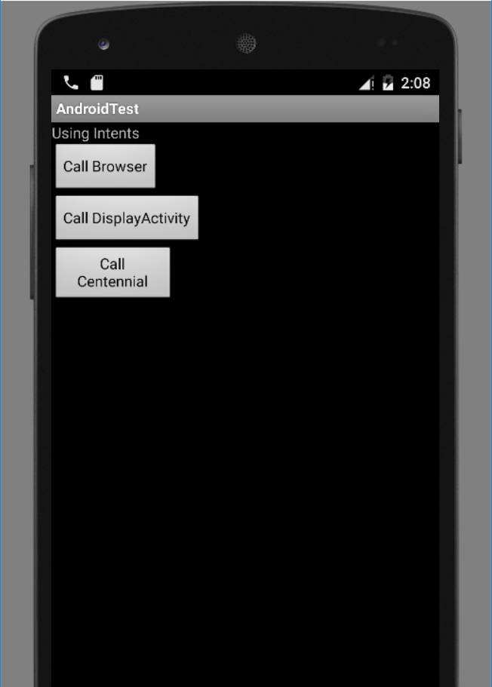
Intents Example

Slide 54

Intents Example

Slide 55
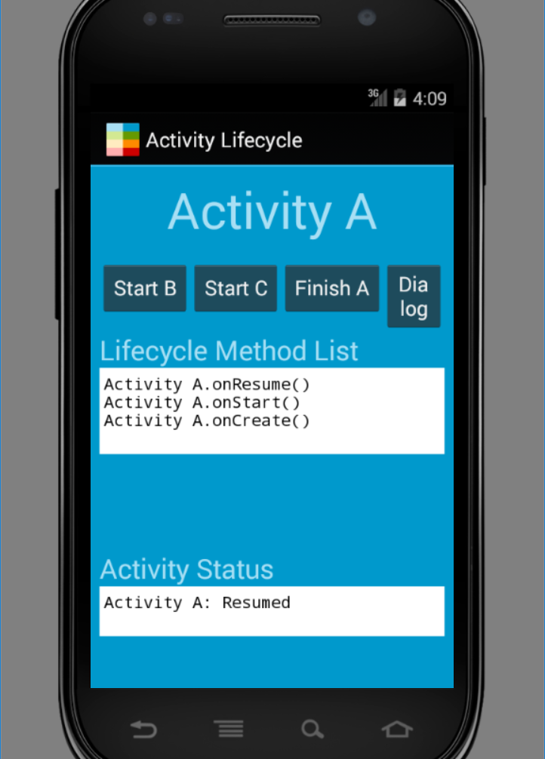
Activity Life Cycle example with Intents

Slide 56
QUESTIONS

Slide 57
Gradle: The new Build System for Android
With Gradle, Android developers can use a simple, declarative DSL to configure Gradle builds supporting a wide variety of Android devices and App stores.
Full Incremental Builds – The new Gradle-based Android build system has been designed for developer efficiency.
Gradle’s support for incremental tasks means you spend less time waiting and more time coding.

Slide 58
Gradle: The new Build System for Android
A Focus on Testing – The Gradle-based Android build system bring a new focus on testing. With Gradle you can run unit and integration tests without creating subprojects. Gradle supports several scenarios for integration testing on build servers.
Test Server API supports Hosted Testing – Integration with Jenkins-based build servers and services from AppThwack, TestDroid, and Manymo means that your build can support complex, massively-parallel integration testing scenarios.

Slide 59
How to Launch another Activity
Let’s see how can we launch another activity.
Build an application with a TextView and a Button. LAB/Assignment. Call the app SecondActivity
If you click on the button, it launches new activity.
Your App must have two activities.
Here!!
Notes:
SecondActivity – 3 Marks lab.

Slide 60
References
Textbook
Android Documentation
https://developer.android.com/guide/components/fundamentals.html
http://developer.android.com/tools/studio/index.html
https://developer.android.com/training/basics/firstapp/creating-project.html
https://developer.android.com/guide/components/activities.html
http://www.vogella.de/articles/AndroidIntent/article.html

